Slide 1
Lesson objective
Title: Multiplication strategies
Aim:
Be able to use a variety of mental strategies for multiplication
Plan:
Daily review: Indices
Multiplication practice
Multiplication strategies
Strategies practice

Slide 2
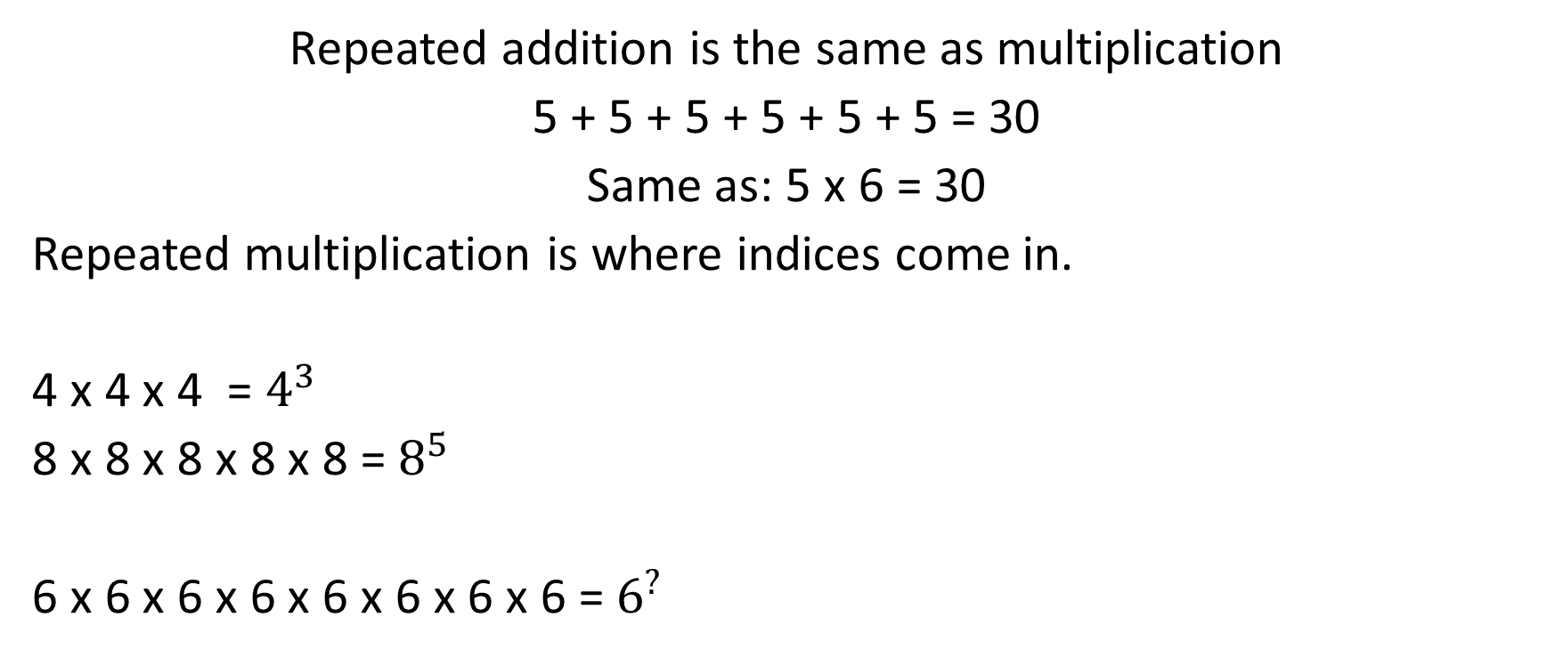
Indices
Repeated addition is the same as multiplication
5 + 5 + 5 + 5 + 5 + 5 = 30
Same as: 5 x 6 = 30
Repeated multiplication is where indices come in.
4 x 4 x 4 = $4^{3}$
8 x 8 x 8 x 8 x 8 = $8^{5}$
6 x 6 x 6 x 6 x 6 x 6 x 6 x 6 = $6^{?}$
This is a lot easier and takes less room… it’s the “simplified” version.

Slide 3


Example
Simplifying multiplication.
2 x 2 x 2 x 2 = $2^{4}$
9 x 9 x 9 = $9^{3}$
10 x 10 x 10 x 10 x 10 x 10 x 10 = ${10}^{?}$
Index number (number of repeats for base number)
$$8^{4}$$
Base number (number being multiplied)
Expanded form
Simplified form

Slide 4
Whiteboards
Simplify:
2 x 2 x 2 x 2 x 2
8 x 8 x 8 x 8
12 x 12 x 12
3 x 3 x 3 x 3 x 3 x 3

Slide 5

Whiteboards
Expand:
$6^{3}$
$9^{5}$
$3^{2}$

Slide 6

Whiteboards
Calculate these indices:
$2^{3}=$
$4^{2 }=$
$1^{50}=$
$3^{3}=$

Slide 7
Multiplication grids
5 minutes to get as much done as possible.
Name on top please.

Slide 8
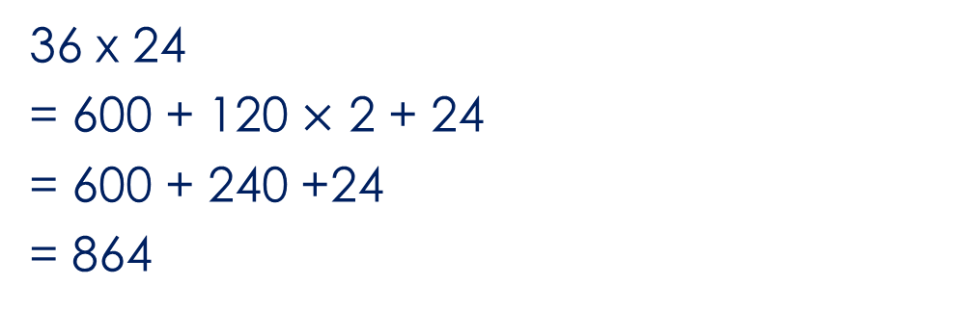
The grid method:
36 x 24
30
6
600
120
20
120
24
4
36 x 24
= 600 + 120 $×$ 2 + 24
= 600 + 240 +24
= 864

Slide 9
Whiteboards
Grid method:
48 x 63
23 x 42
35 x 45

Slide 10
The lattice (Chinese) method:
36 x 24
3
6
0
1
6 x 2 =12
2 x 3 = 06
6 x 4 = 24
3 x 4 = 12
Add the diagonals
6
2
2
1
2
8
2
4
4
6
4
36 x 24
= 864

Slide 11
Whiteboards
Lattice method:
48 x 63 =
12 x 23 =
41 x 22 =

Slide 12
The doubling (Egyptian) method:
36 x 24
Left (36)
1
2
4
8
16
32
Right
24
48
96
192
384
768
36 = 32 + 4
36 x 24
= 96 + 768
= 864

Slide 13
Doubling method: 48 x 63

Slide 14
Independent practice
Complete the task sheet provided
I have spares.

